Slide 1
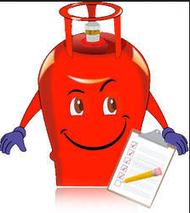
Database Management Systems Gas Management System
By
B V V L N BHARGAV (2110030150 )
JAINA VAMSHI (2110030153)
JATIN MISHRA (2110030212)
U SAI SUBRAHMANYAM(2110030293)
Under the guidance of
P. SREE LAKSHMI

Slide 2

Problem statement and domain:-
Design a client-facing online gas booking system that would allow them to book gas barrels whenever they are in dire need of them. Instead of using the traditional way of obtaining gas barrels over the phone, customers should be able to easily arrange for them and even make monetary transactions for the same
Problem Statement Most of the LPG stations in Rural areas often experience long queue of people spending several hours waiting to buy gas. This problem of time wastage at the stations has persisted for several years

Slide 3
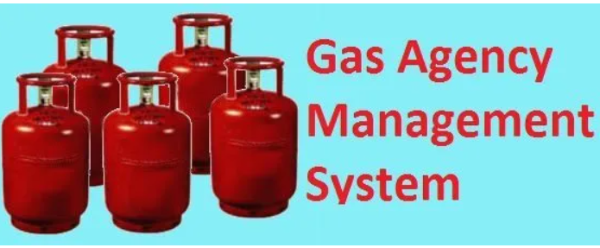
Existing solutions:-
IVRS (using landline phones)
SMS
We can visit near by agency and book a “LPG” Cylinder in a offline mode.

Slide 4

Proposed Algorithm Design Technique:-
What is the technique?
The goal of system design is to transform the information collected about the project into the blueprint structure which will serve as a base while constructing the system. It is considered to be an unwieldy process as most of the errors are introduced in this phase.

Slide 5
How is it suitable for your application
However , if an error gets unnoticed in the later process it may become difficult to track them down. In our system, we are developing a system which helps in customer book a gas. The new system will maintain and store all the records without any overhead cost. All the process of the booking will be web-based online which makes it robust and globally available.

Slide 6
What do you know about the solution of it using proposed design method?
It will have transaction details which will store all the information regarding the payment of the booking as well as the total transaction record will be maintained which holds the record of a number of commercial and domestic cylinders that have been sold on a particular day.
It will minimize the problems faces by both customers and the agency in the duration.

Slide 7

WORKING:-
1. Consumers can book the refill by just one click , they can post queries or
complaints.
2. It needs only username and password . If they don't have one , the valid consumers can get the username and passwords with simple registration process.
3. The Admin can only access the database and he can add the consumers
and staff . So the system is secured.
4. The authorized staff can see the bookings and the consumer details without any hassle .He can mark the status whether the refill delivered or not .

Slide 8

Advantages:-
Consumer Record is maintained.
Edit, update, and deletion of the record.
Online booking of the gas through internet from any point.
Check consumer is valid to book a gas.
Valid booking followed by the payments process.
Booking records should be maintaining.

Slide 9

Data Structures needed
MYSQL-SQL commands(DDL,DML,DCL,TCL,DQL).
Architecture used-3 tier DBMS architecture.
TerraER-EER Diagram(to understand the workflow).
(for the management of the database of system).

Slide 10
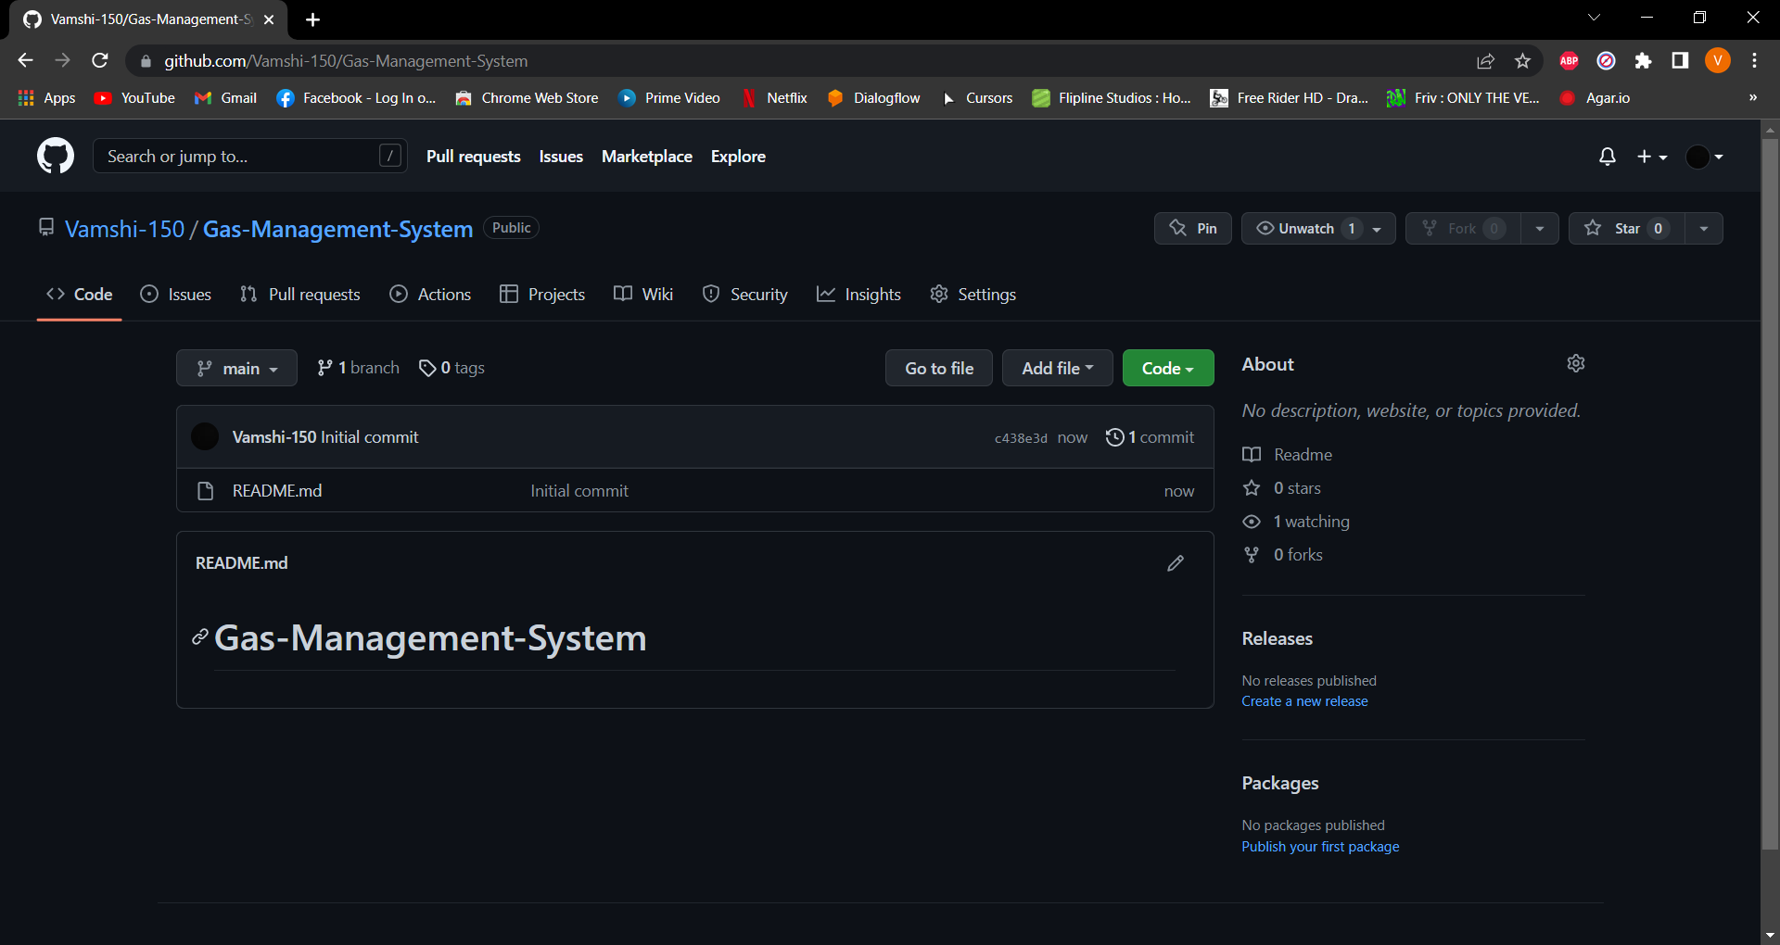
Git hub setup(We created a Git hub Link)

Slide 11
Division of work among the group members
ER Diagram-Jatin(2110030212).
Template(PPT)- Subrahmanyam(2110030293),Jatin(2110030212).
Report Writing-Bhargav(2110030150).
Application(website) Interface-Vamshi(2110030153).
Data base Management - Bhargav(2110030150),Vamshi(2110030153),Jatin(2110030212), Subrahmanyam(2110030293).

